Slide 1

Database Management Systems
Shamim Ahmad

Slide 2
Normalization

Slide 3
Keep Decomposition Conditions
Decompose the relation schema Lending-schema into:
Branch-schema = (branch-name, branch-city,assets)
Loan-info-schema = (customer-name, loan-number, branch-name, amount)
All attributes of an original schema (R) must appear in the decomposition (R₁, R₂):
R = R₁ ∪ R₂
Lossless-join decomposition. For all possible relations r on schema R
r = ∏_{R1} (r) ∏_{R2} (r)
A decomposition of R into R₁ and R₂ is lossless join if and only if at least one of the following dependencies is in F⁺:
R₁ ∩ R₂ → R₁
R₁ ∩ R₂ → R₂

Slide 4
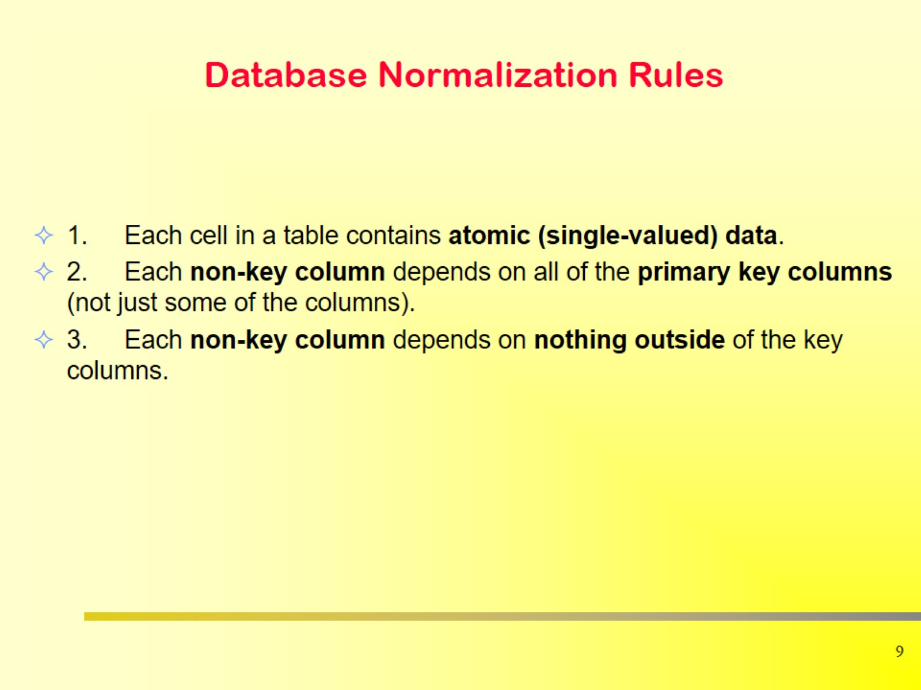
Database Normalization Rules

Slide 5
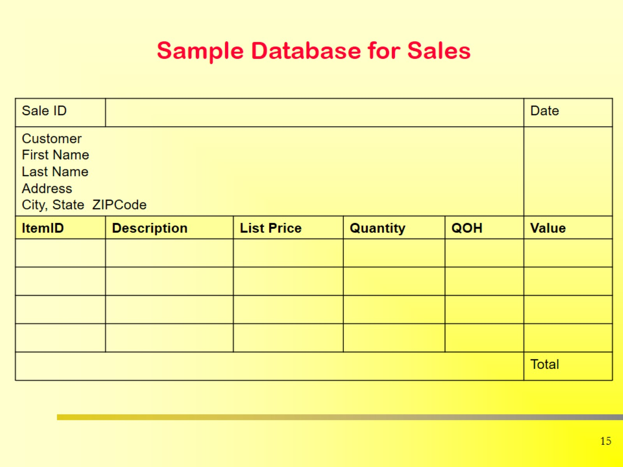
Sample Database for Sales

Slide 6
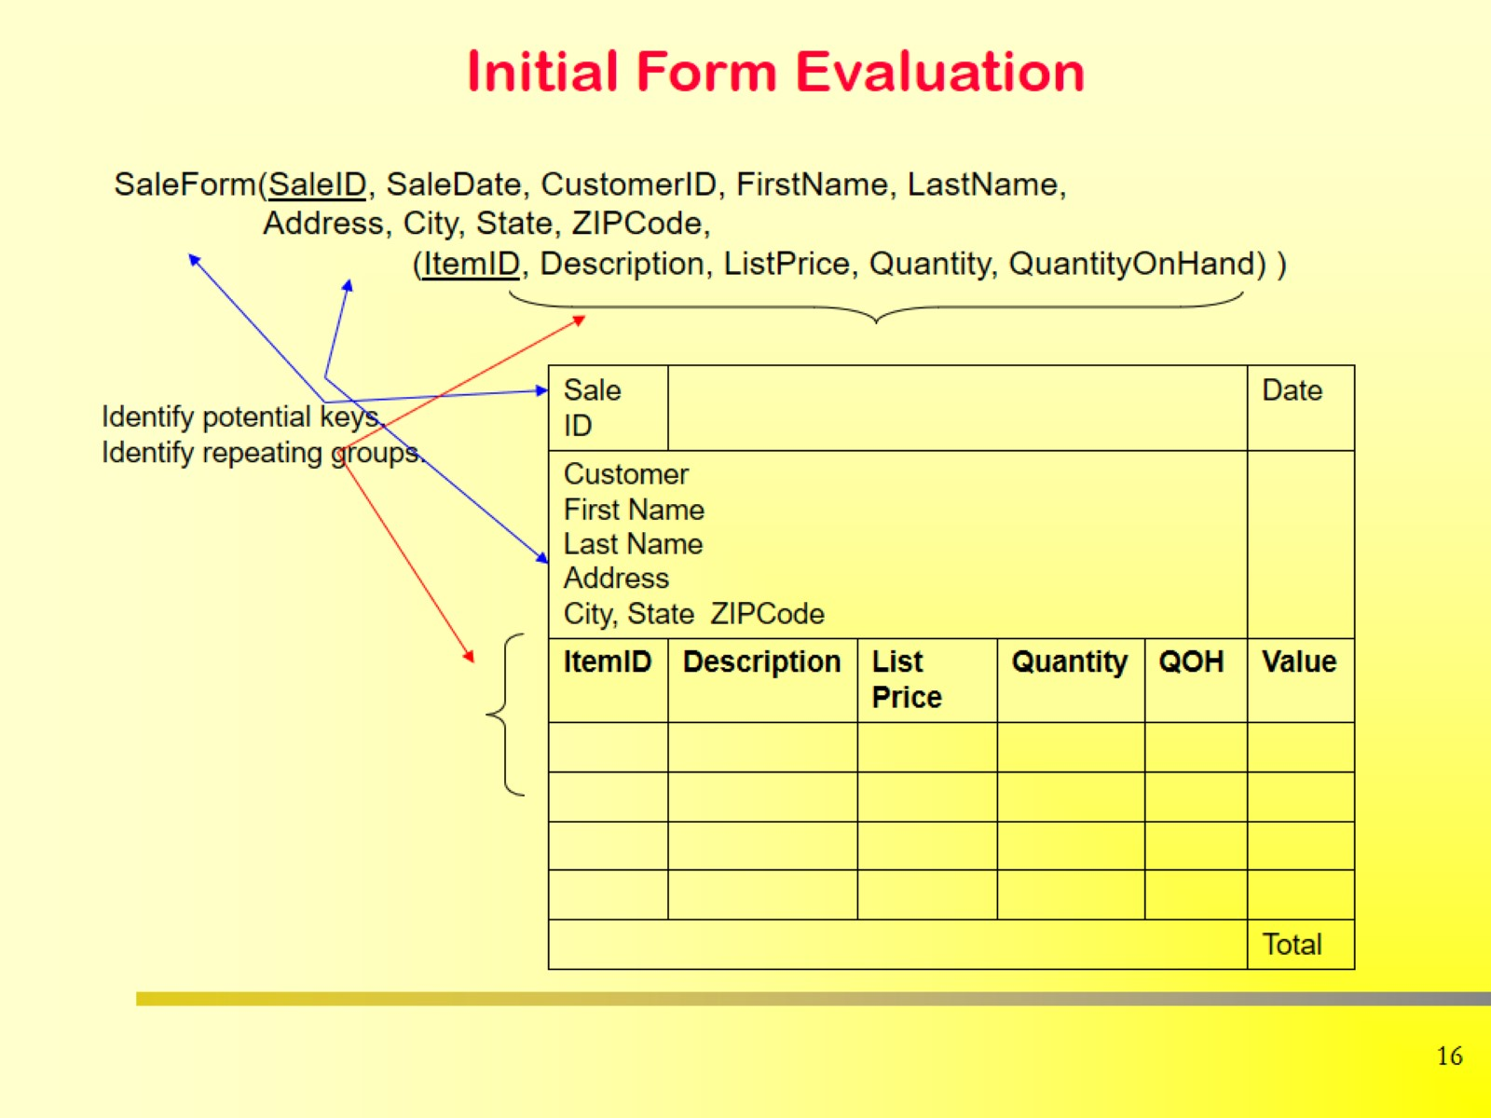
Initial Form Evaluation

Slide 7
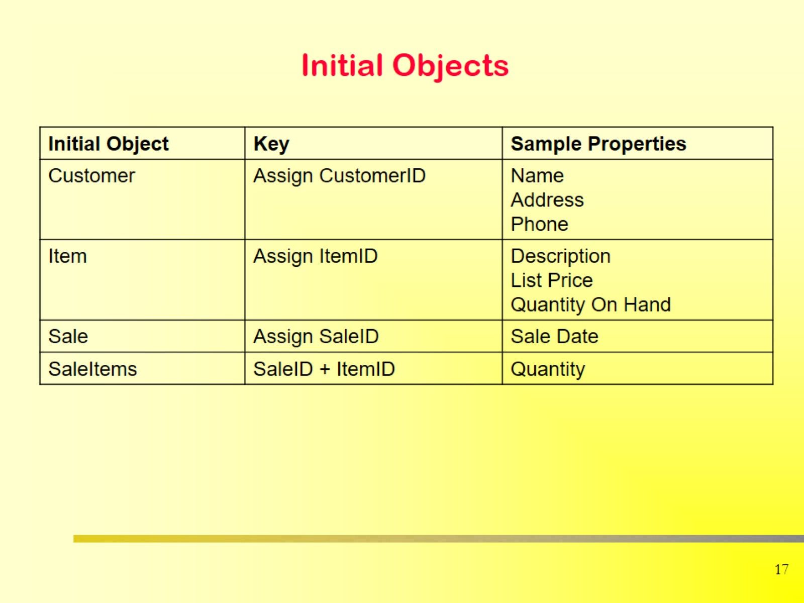
Initial Objects

Slide 8

Initial Form Evaluation

Slide 9
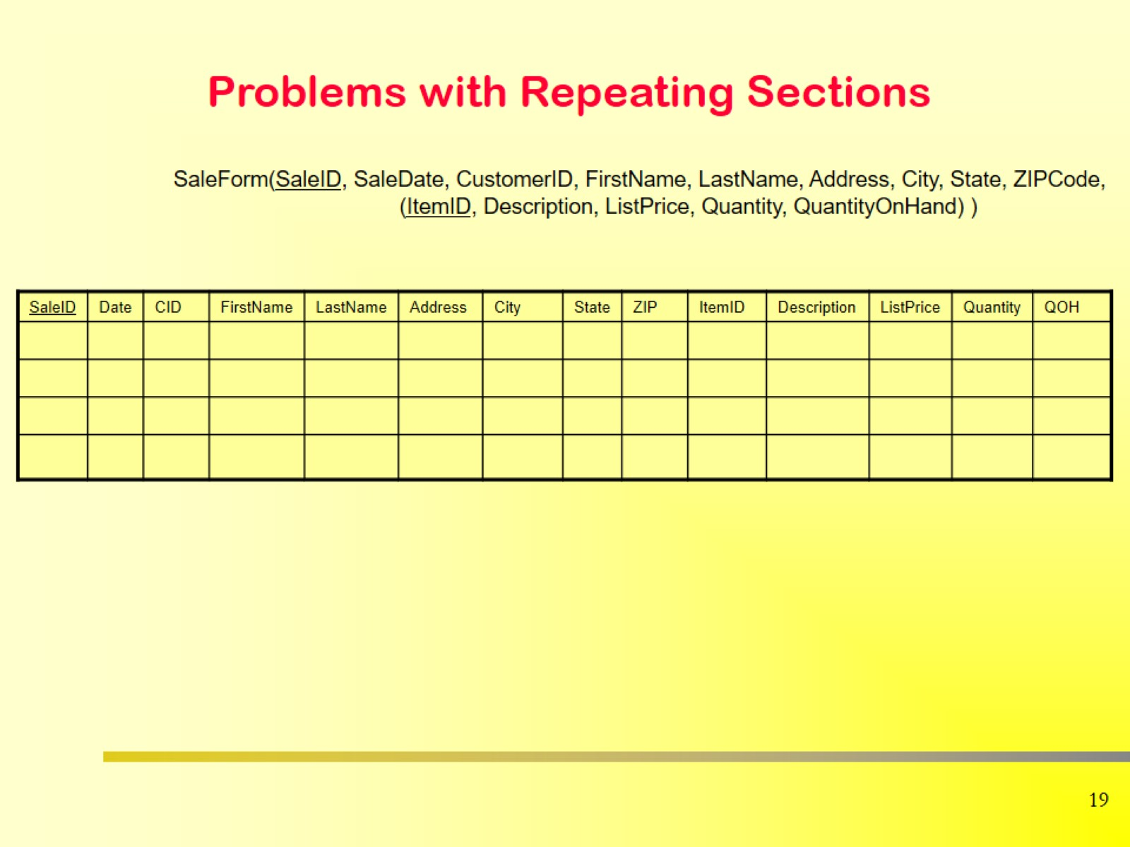
Problems with Repeating Sections

Slide 10
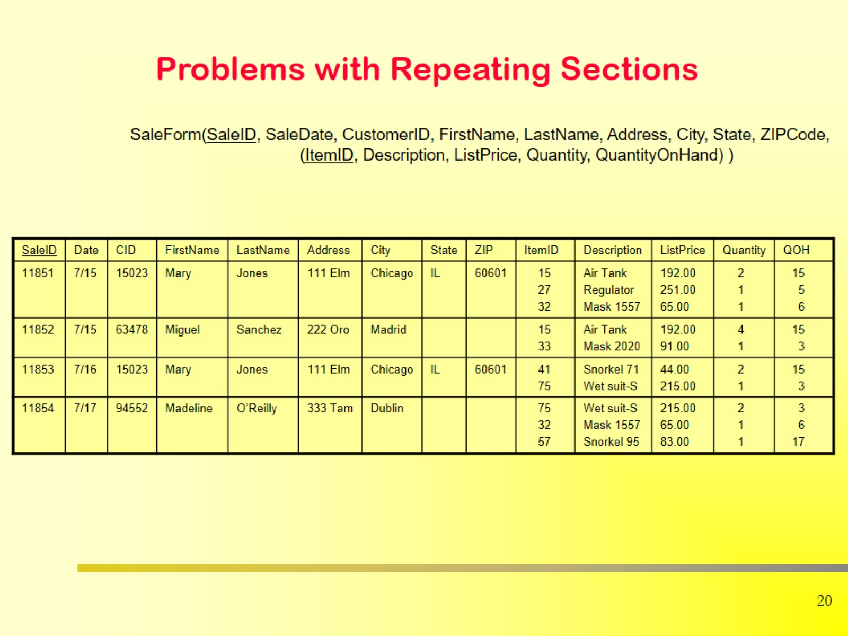
Problems with Repeating Sections

Slide 11
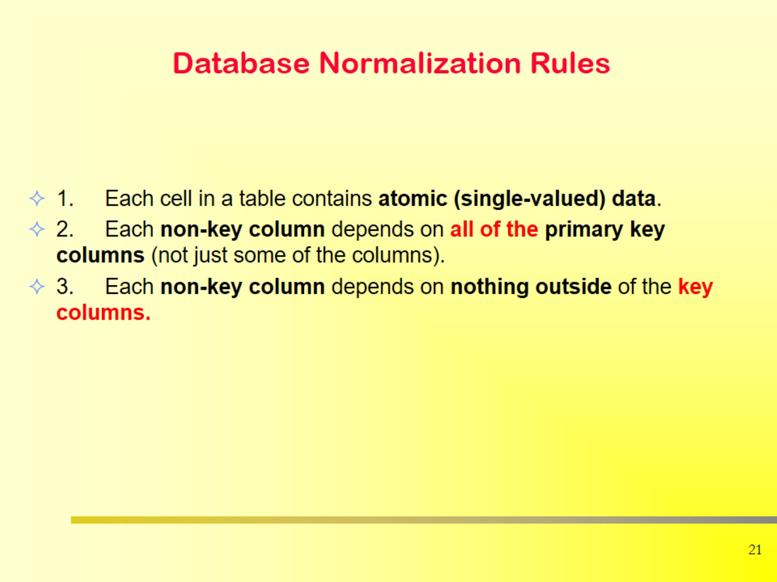
Database Normalization Rules

Slide 12
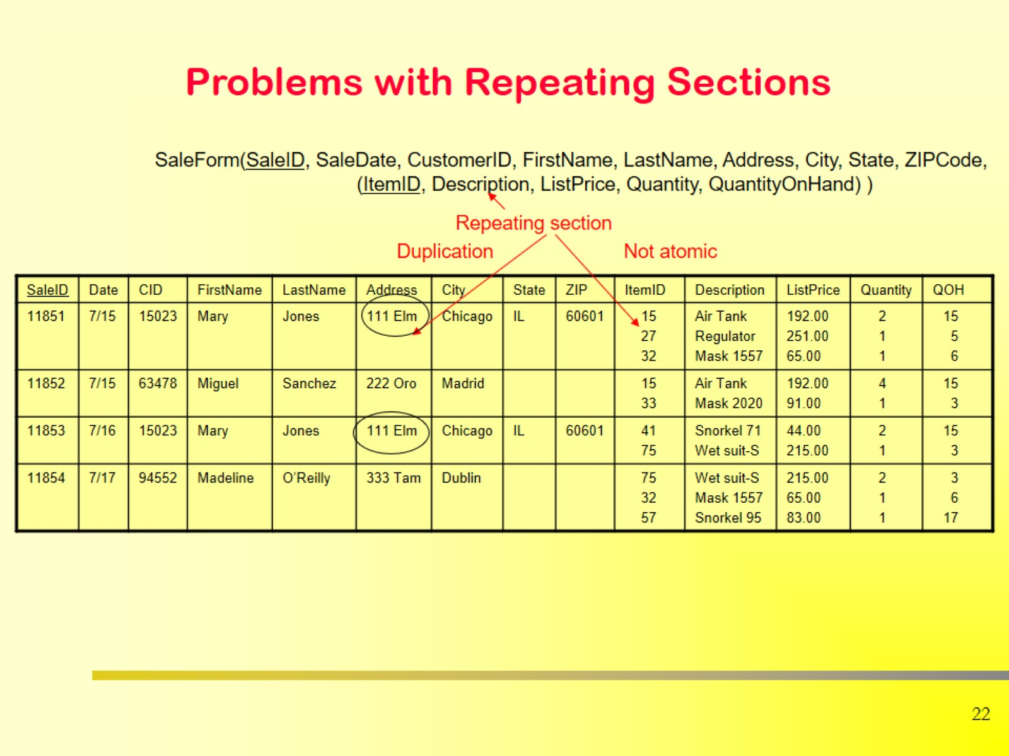
Problems with Repeating Sections

Slide 13
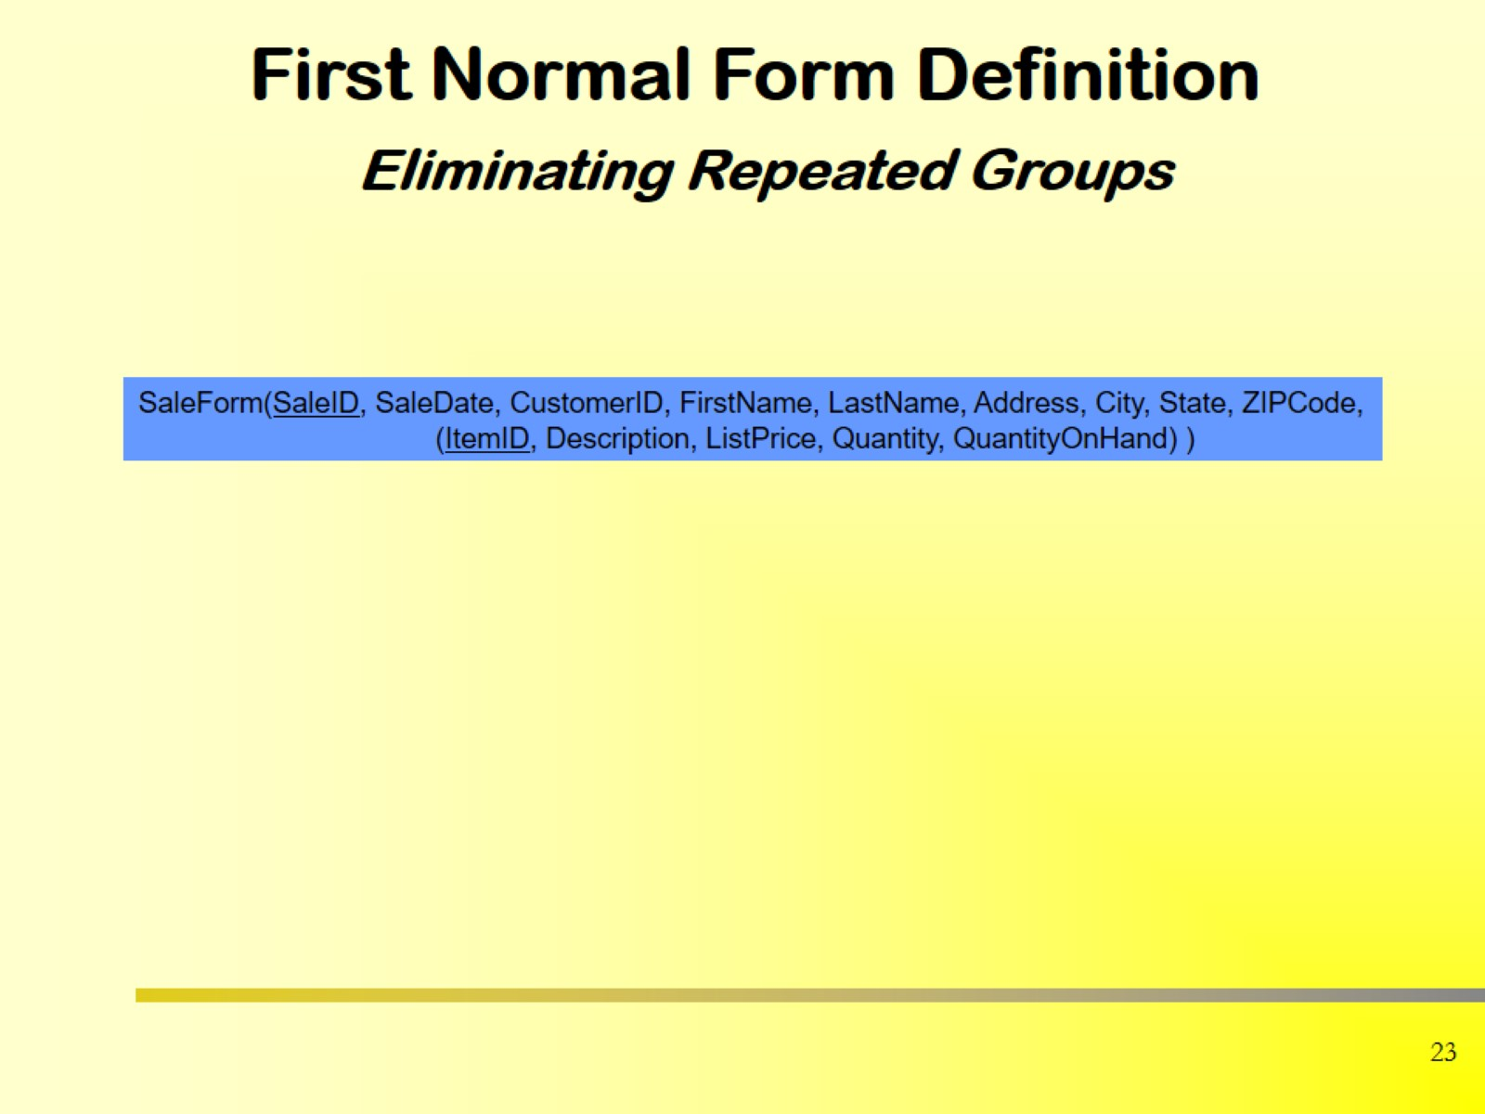
First Normal Form Definition Eliminating Repeated Groups

Slide 14
Definition
A table is said to be in First Normal Form (1NF) if:
Each column contains only atomic (indivisible) values — no multiple or composite values in a single field.
Each record (row) is unique — no duplicate rows.
Each field contains values of the same type — a column should hold values of a single data type.

Slide 15
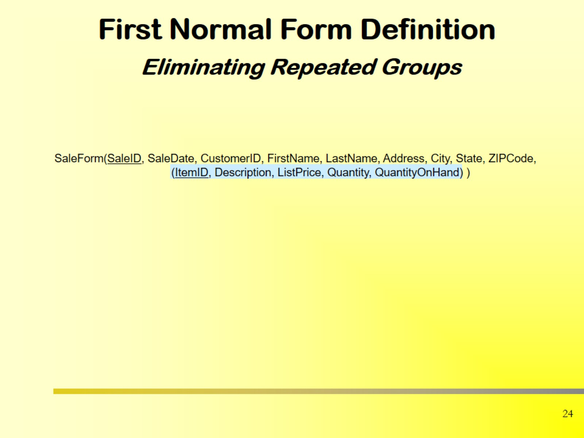
First Normal Form Definition Eliminating Repeated Groups

Slide 16
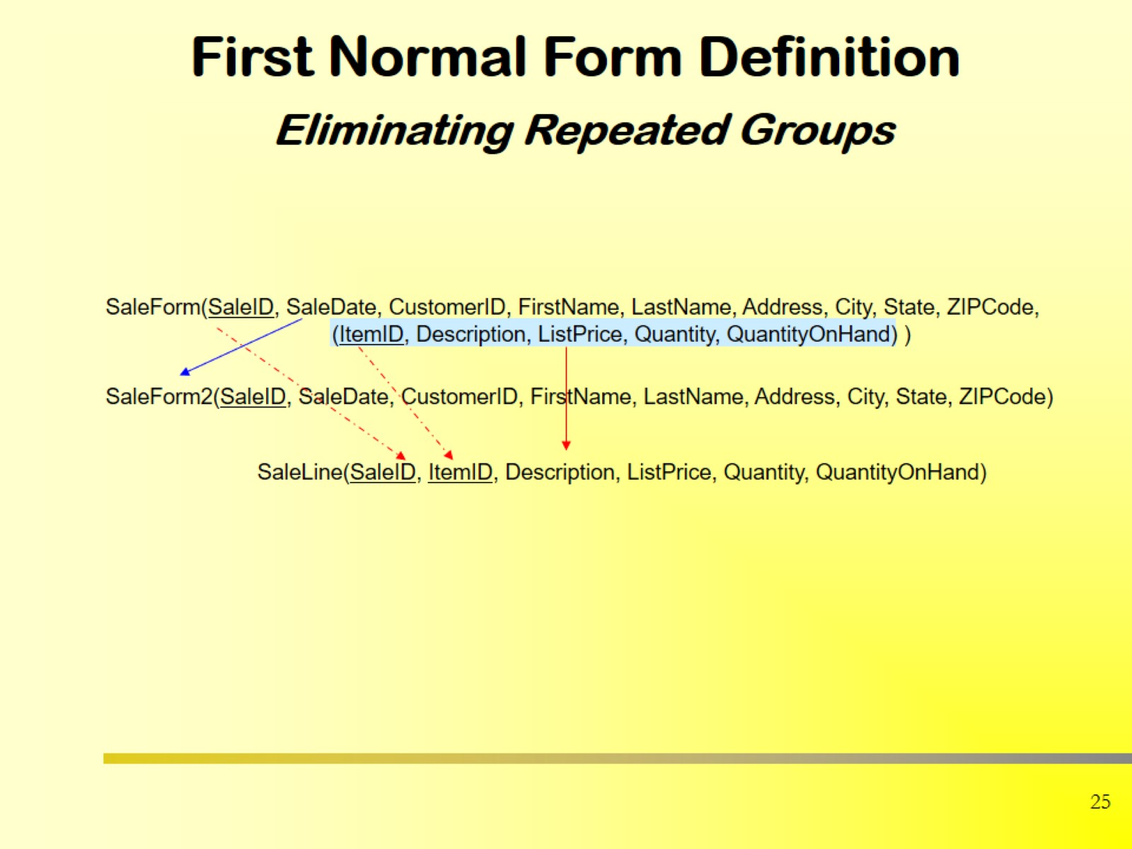
First Normal Form Definition Eliminating Repeated Groups

Slide 17
Keep Decomposition Conditions
Decompose the relation schema Lending-schema into:
Branch-schema = (branch-name, branch-city,assets)
Loan-info-schema = (customer-name, loan-number, branch-name, amount)
All attributes of an original schema (R) must appear in the decomposition (R₁, R₂):
R = R₁ ∪ R₂
Lossless-join decomposition. For all possible relations r on schema R
r = ∏_{R1} (r) ∏_{R2} (r)
A decomposition of R into R₁ and R₂ is lossless join if and only if at least one of the following dependencies is in F⁺:
R₁ ∩ R₂ → R₁
R₁ ∩ R₂ → R₂

Slide 18
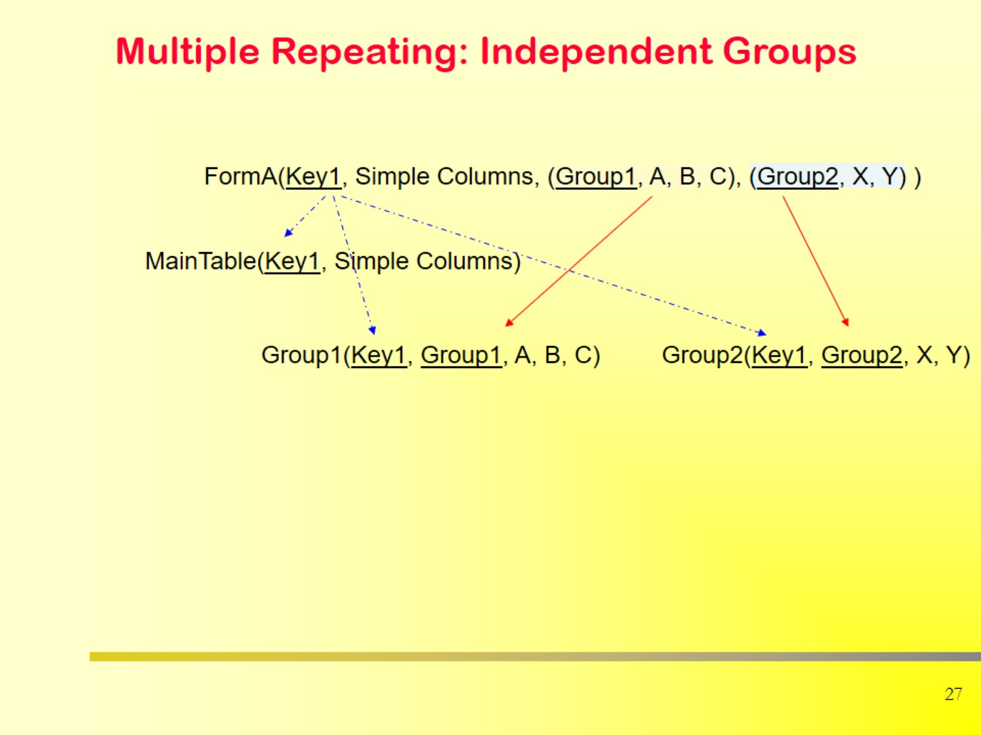
Multiple Repeating: Independent Groups

Slide 19

First Normal Form Definition Eliminating Repeated Groups

Slide 20
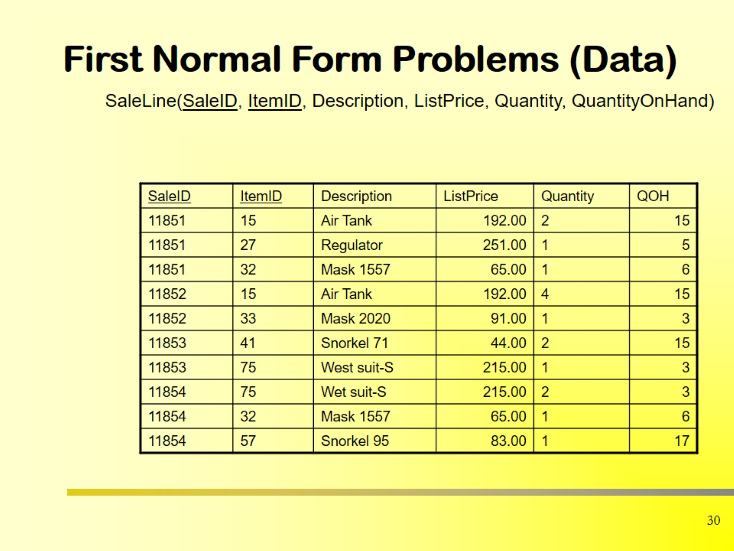
First Normal Form Problems (Data)

Slide 21
Student_ID | Name | Subjects
1 | Rafi | Math, English
2 | Sima | Physics, Chemistry

Slide 22
Student_ID | Name | Subjects
1 | Rafi | Math, English
2 | Sima | Physics, Chemistry
Student_ID | Name | Subject
1 | Rafi | Math
1 | Rafi | English
2 | Sima | Physics
2 | Sima | Chemistry

Slide 23

Database Normalization Rules

Slide 24
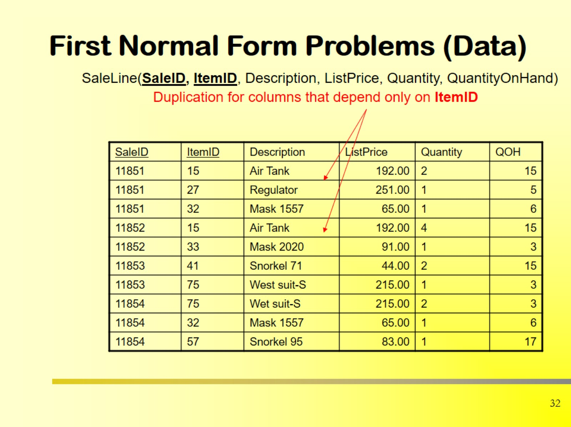
First Normal Form Problems (Data)

Slide 25
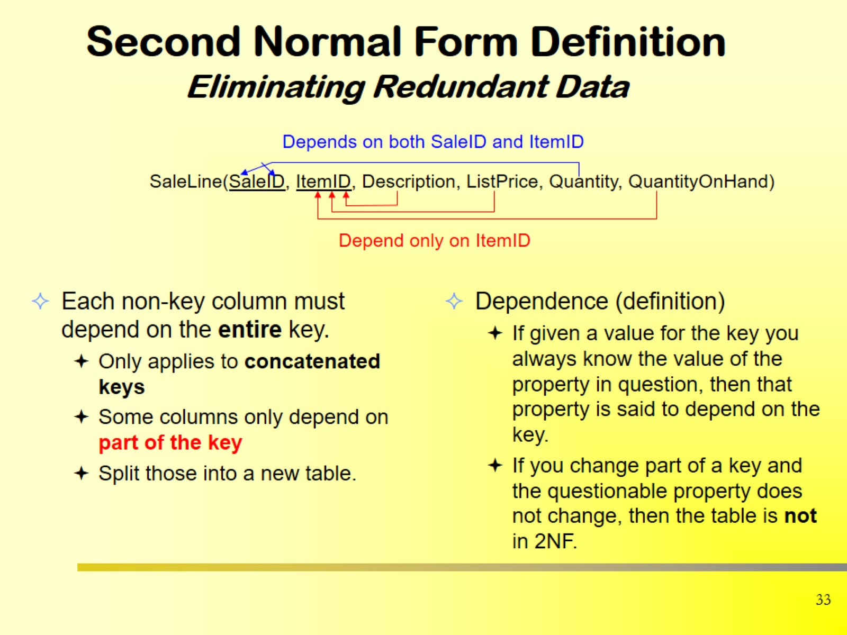
Second Normal Form Definition Eliminating Redundant Data

Slide 26
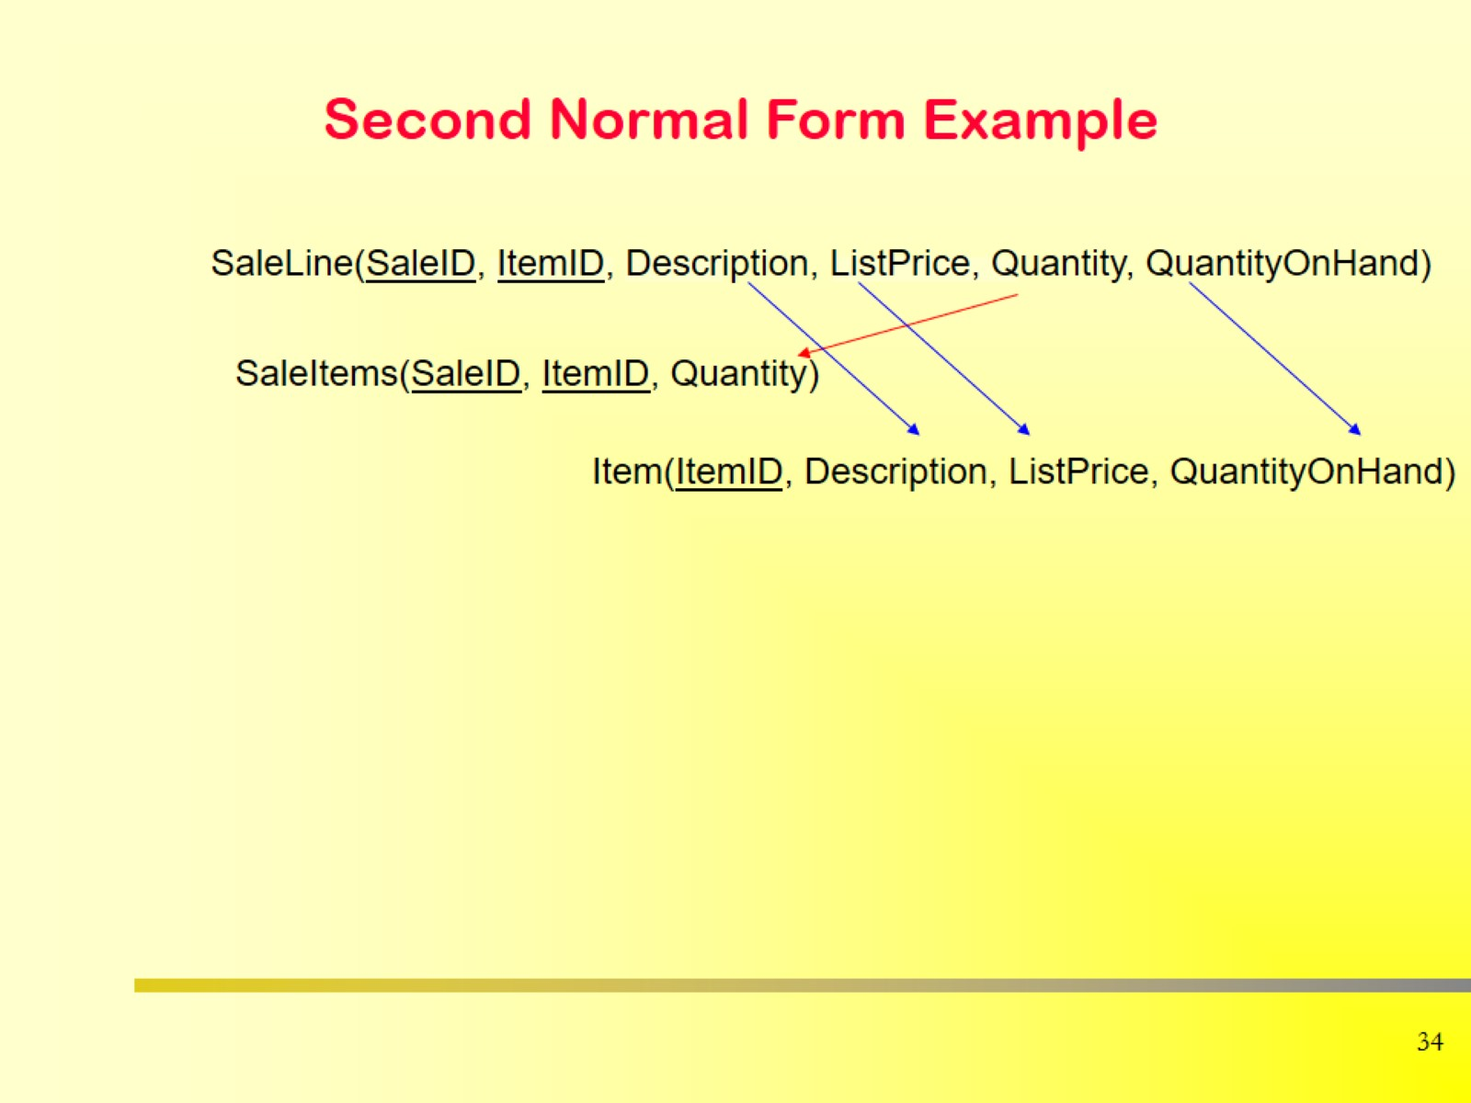
Second Normal Form Example

Slide 27
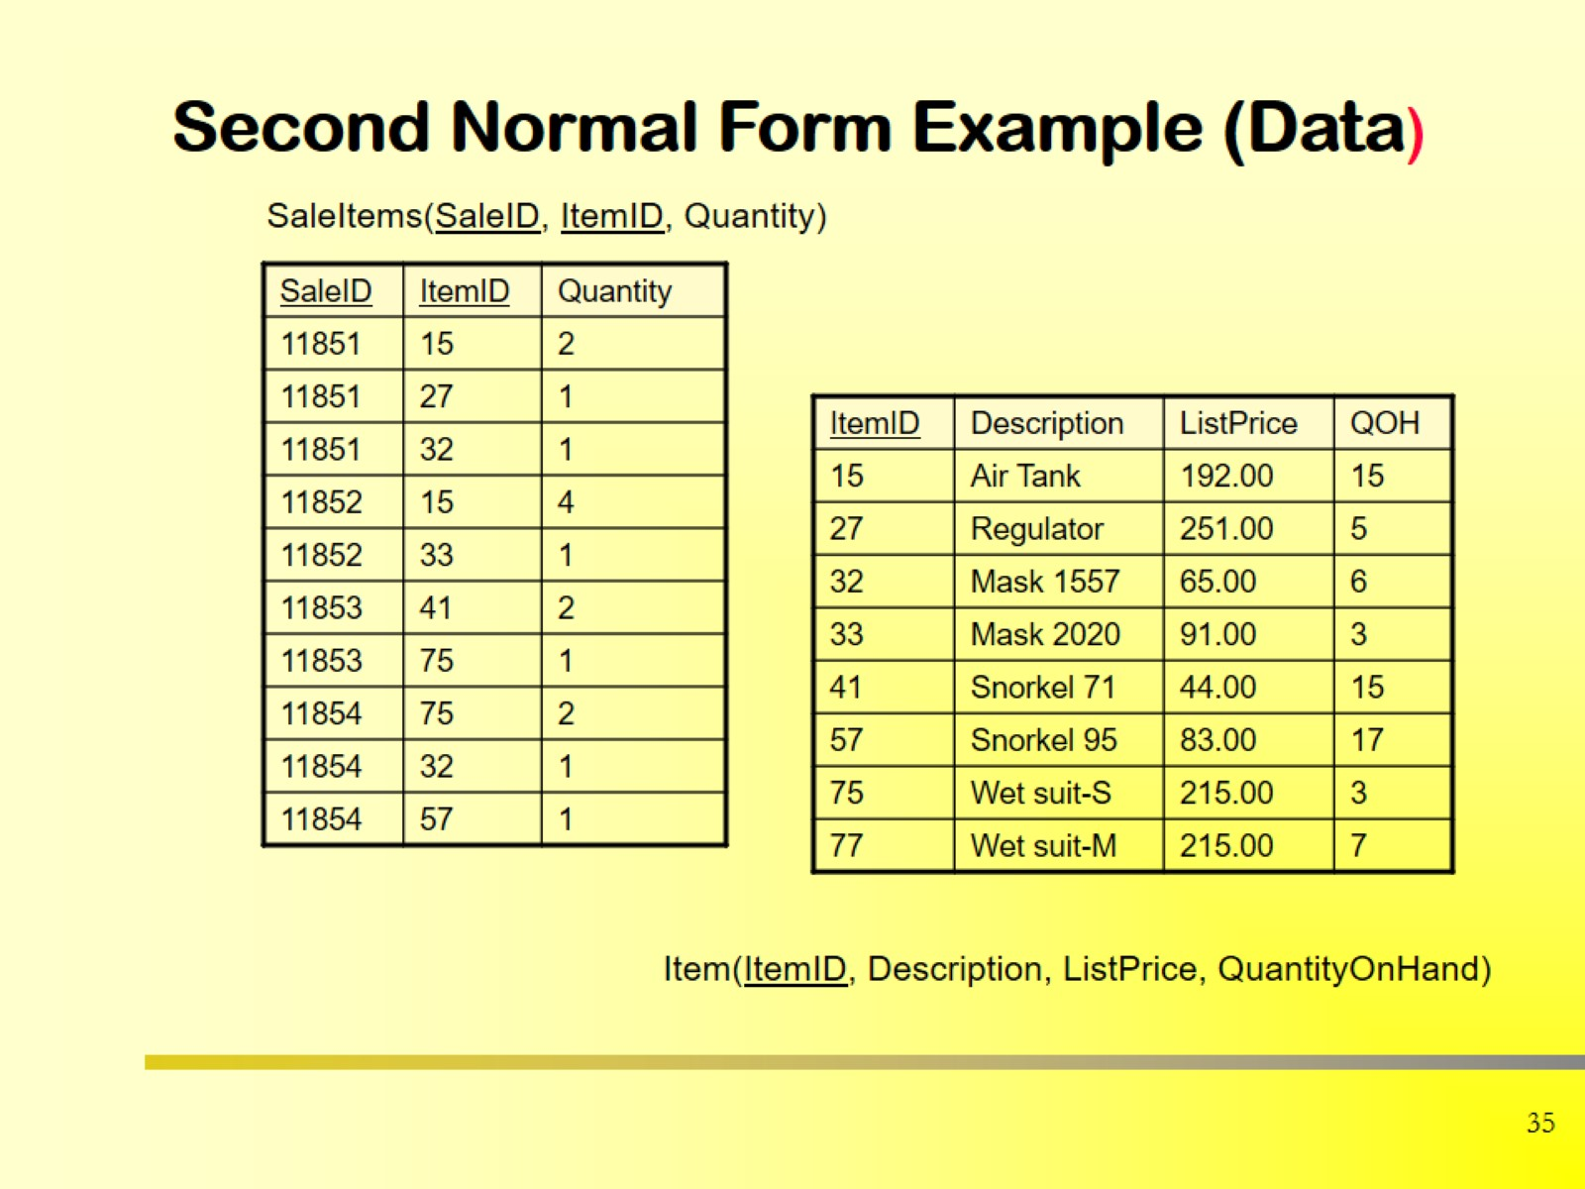
Second Normal Form Example (Data)

Slide 28
🔹 Definition: Second Normal Form (2NF)
A table is in Second Normal Form (2NF) if:
It is already in First Normal Form (1NF), and
Every non-key attribute (i.e., every column that is not part of a primary key) is fully functionally dependent on the entire primary key — not just on a part of it.

Slide 29
Student_ID | Course_ID | Student_Name | Course_Name | Instructor
1 | CSE101 | Rafi | DBMS | Rahim Sir
2 | CSE101 | Sima | DBMS | Rahim Sir
1 | CSE102 | Rafi | Programming | Karim Sir

Slide 30
Student_ID | Course_ID | Student_Name | Course_Name | Instructor
1 | CSE101 | Rafi | DBMS | Rahim Sir
2 | CSE101 | Sima | DBMS | Rahim Sir
1 | CSE102 | Rafi | Programming | Karim Sir
Primary Key = (Student_ID, Course_ID) — combination of both.
Student_Name depends only on Student_ID.
Course_Name and Instructor depend only on Course_ID.
👉 Therefore, we have partial dependencies → not in 2NF.

Slide 31
Student_ID | Course_ID | Student_Name | Course_Name | Instructor
1 | CSE101 | Rafi | DBMS | Rahim Sir
2 | CSE101 | Sima | DBMS | Rahim Sir
1 | CSE102 | Rafi | Programming | Karim Sir
Student_ID | Student_Name
1 | Rafi
2 | Sima
Course_ID | Course_Name | Instructor
CSE101 | DBMS | Rahim Sir
CSE102 | Programming | Karim Sir
Student_ID | Course_ID
1 | CSE101
1 | CSE102
2 | CSE101

Slide 32
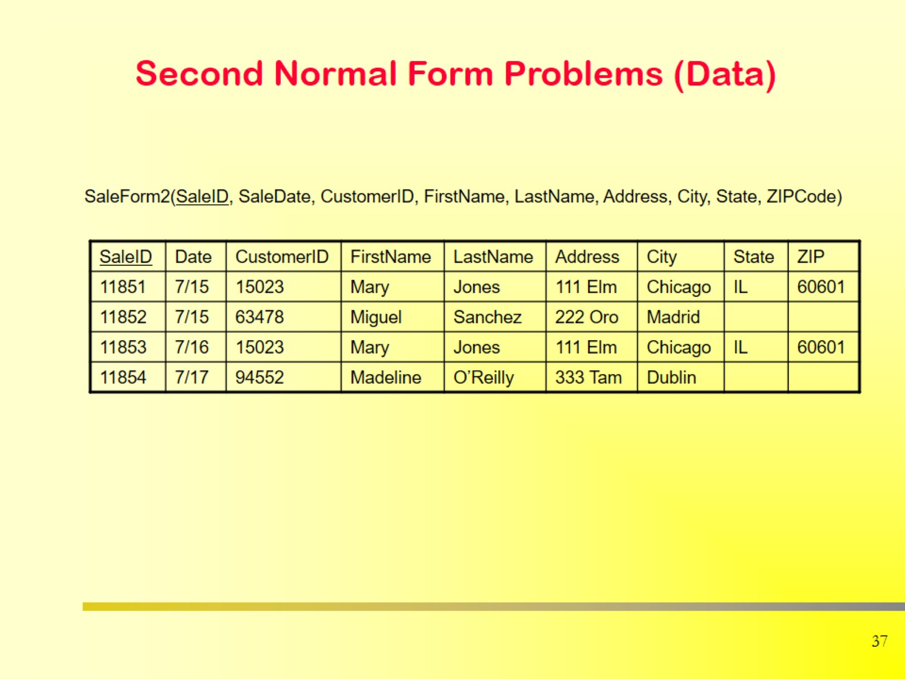
Second Normal Form Problems (Data)

Slide 33

Database Normalization Rules

Slide 34
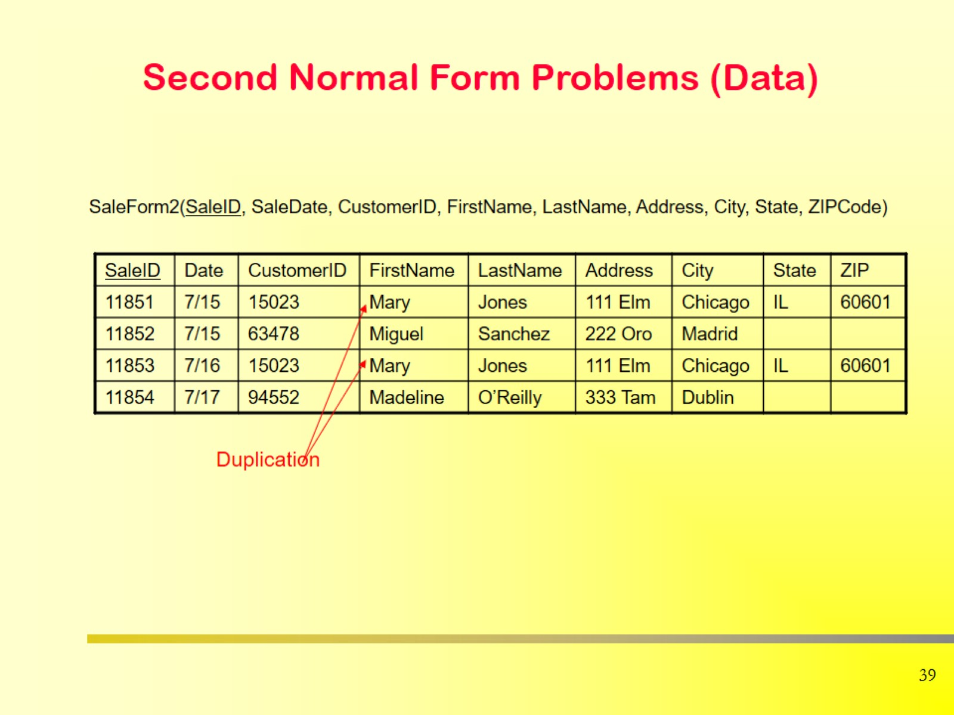
Second Normal Form Problems (Data)

Slide 35
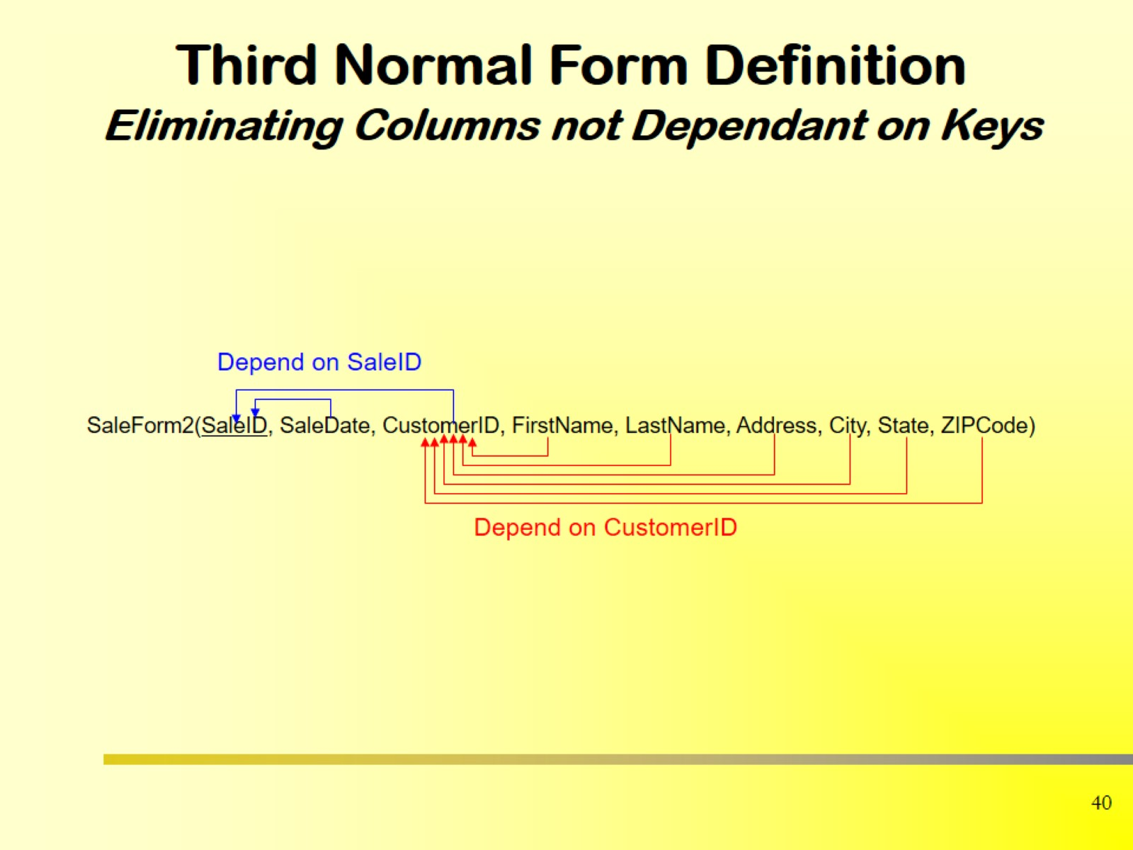
Third Normal Form Definition Eliminating Columns not Dependant on Keys

Slide 36
Definition: Third Normal Form (3NF)
A table is in Third Normal Form (3NF) if:
It is already in Second Normal Form (2NF), and
No non-key attribute depends on another non-key attribute — that is, no transitive dependency exists.

Slide 37
What is a Transitive Dependency?
A transitive dependency occurs when: A → B and B → C, then A → C indirectly.
In database terms: If Student_ID → Department_ID and Department_ID → Department_Name, then Student_ID → Department_Name (transitively)

Slide 38
Student_ID | Student_Name | Department_ID | Department_Name
1 | Rafi | D01 | CSE
2 | Sima | D01 | CSE
3 | Hasan | D02 | EEE

Slide 39
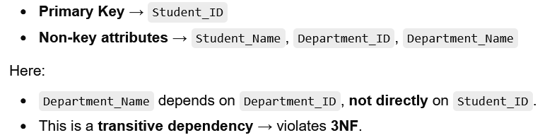
Student_ID | Student_Name | Department_ID | Department_Name
1 | Rafi | D01 | CSE
2 | Sima | D01 | CSE
3 | Hasan | D02 | EEE

Slide 40
Student_ID | Student_Name | Department_ID
1 | Rafi | D01
2 | Sima | D01
3 | Hasan | D02
Department_ID | Department_Name
D01 | CSE
D02 | EEE

Slide 41
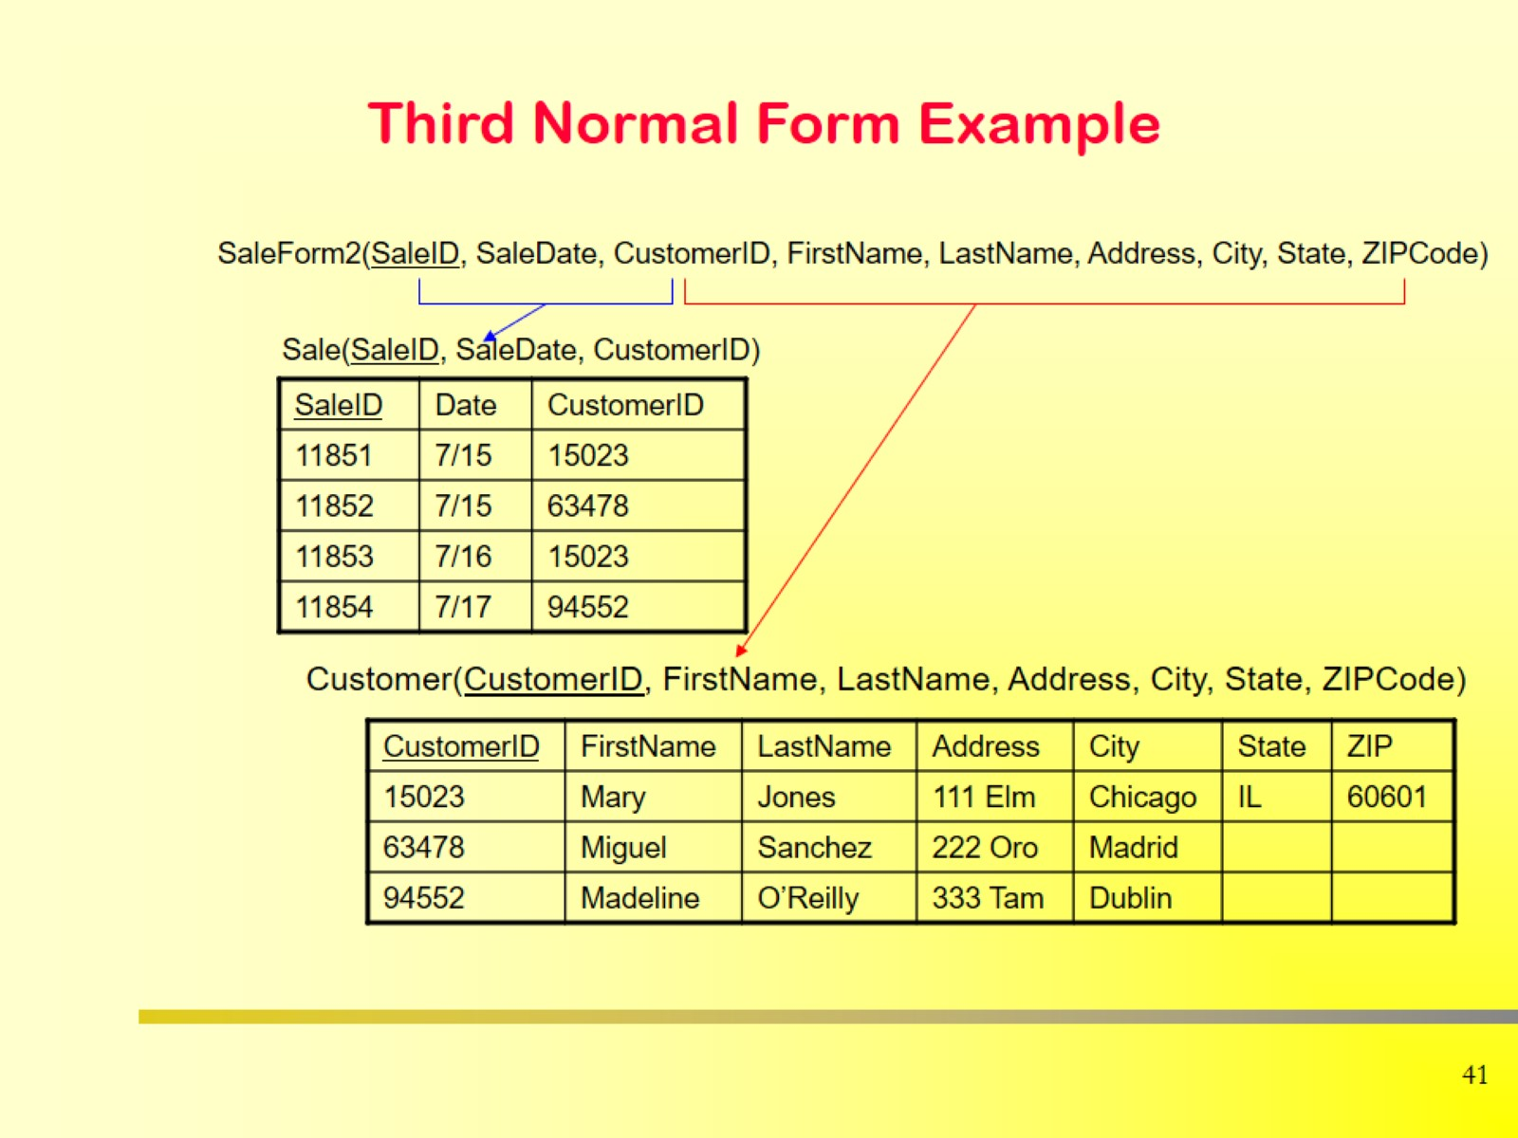
Third Normal Form Example

